Slide 1
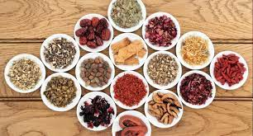
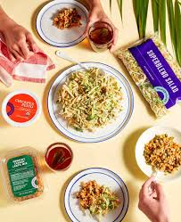
Project : Online Recipe Ingredient Shopping
Business Unit : Apps NA
.Net LOT N-6 15 Feb-21 Left Shift Batch
Team 3
1. Prachi Sawarkar.
2. Pradhunya Chaudhari.
3. Sakshi Joshi.
4. Samidha Sahu.
5. Vijendra Mishra.

Slide 2
INTRODUCTION
We have designed our Online Recipe Ingredient shopping application in such a way that the owner has some functionalities that will help him/her to manage their store and also the second side of our application that is the customer, even there are various functions for him/her.

Slide 3
TASK
Online Recipe Ingredient shopping application,
- So that ADMIN can add, delete, modify Recipe and ingredient also he can view order details and has the rights of viewing and editing shipping details.
- So that CUSTOMER can view the product and able to add selected product in shopping cart. Customer can place the order for selected product and provide his Payment(Cash On Delivery) and Shipping details.

Slide 4
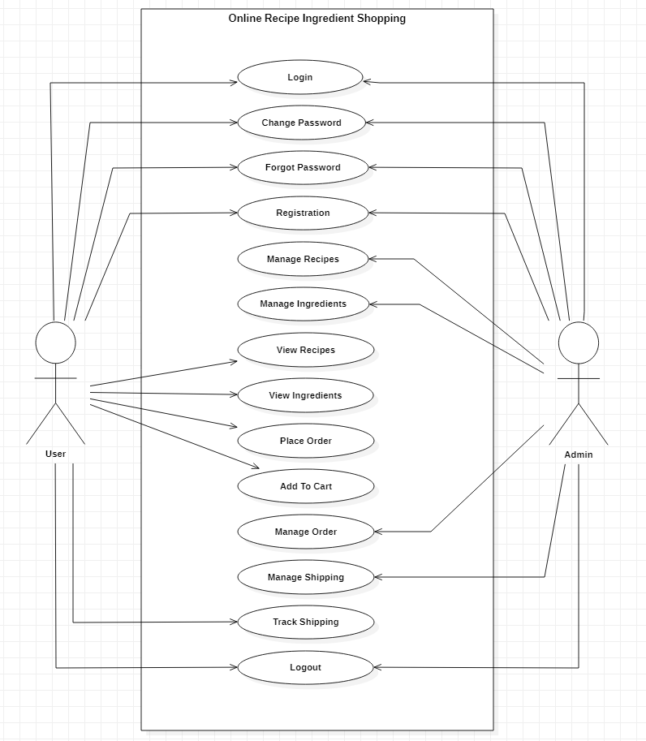
Use Case Diagram

Slide 5
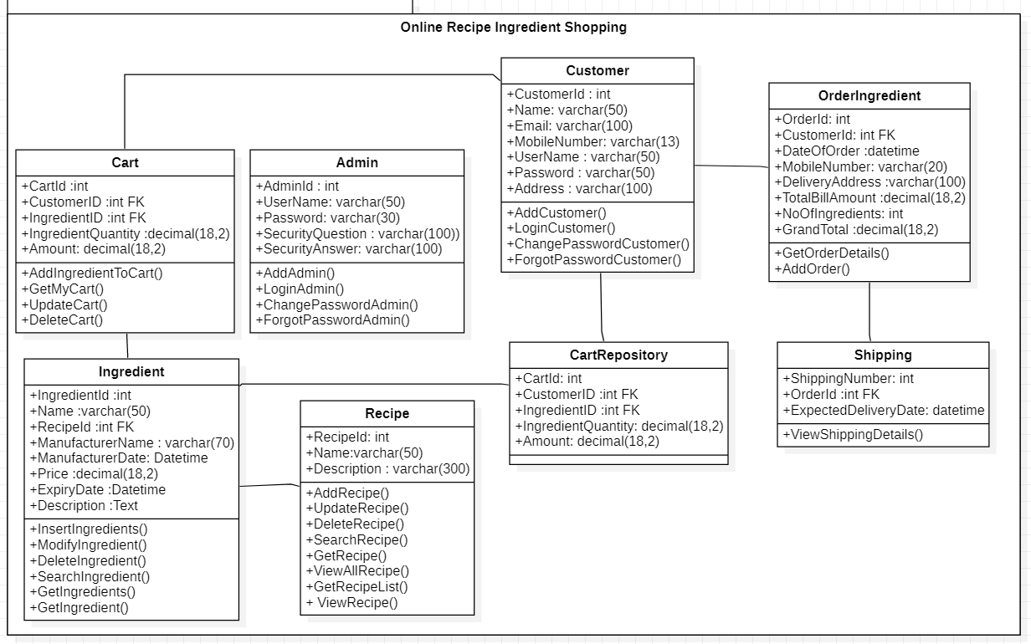
Class Diagram

Slide 6
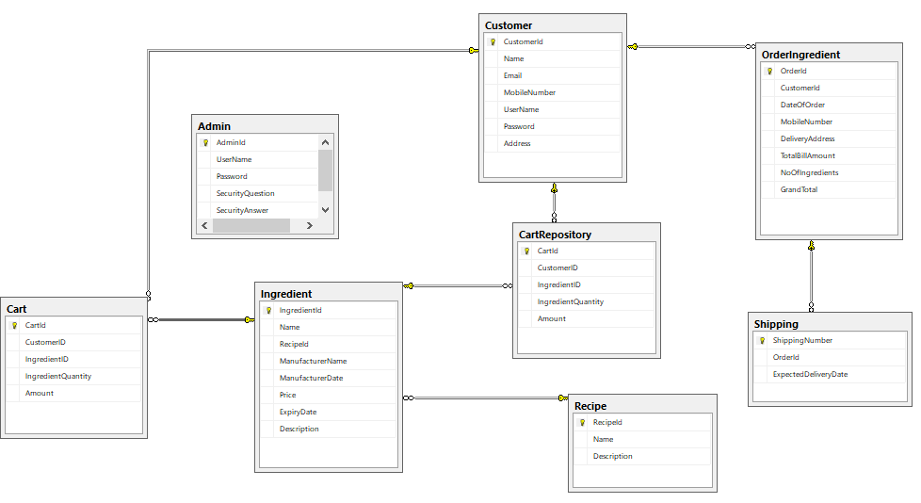
Database Diagram

Slide 7
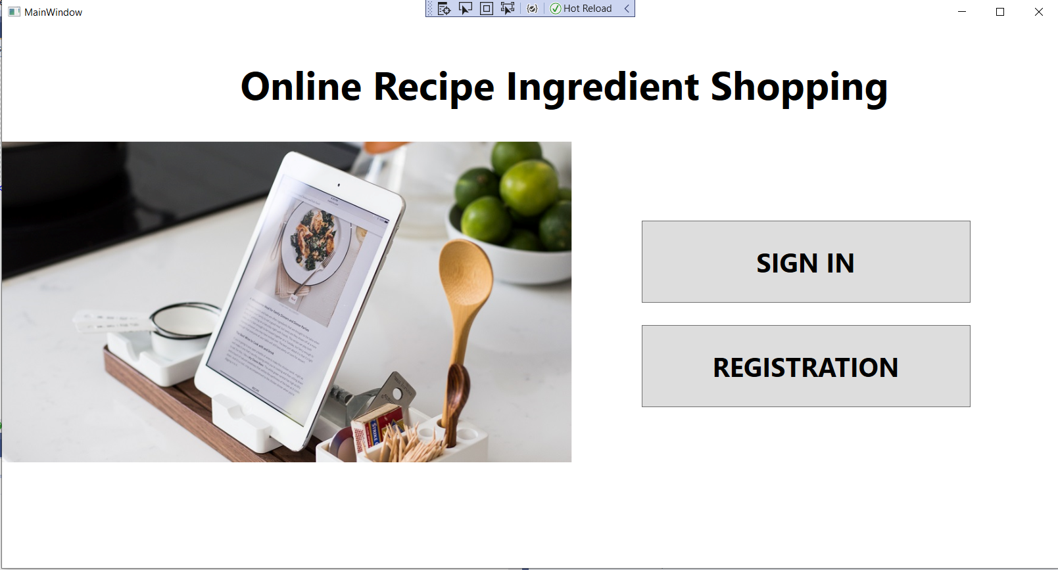
This is the main window of our project, this gives two options to the user that are sign in and registration for both admin as well as customer.

Slide 8
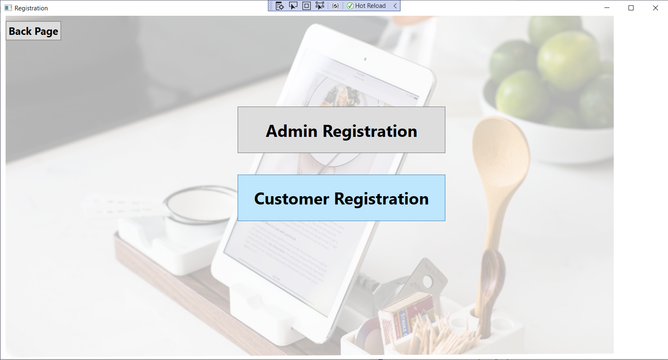
This is the registration page, here the user has the right to register himself/herself as admin or customer if the

Slide 9
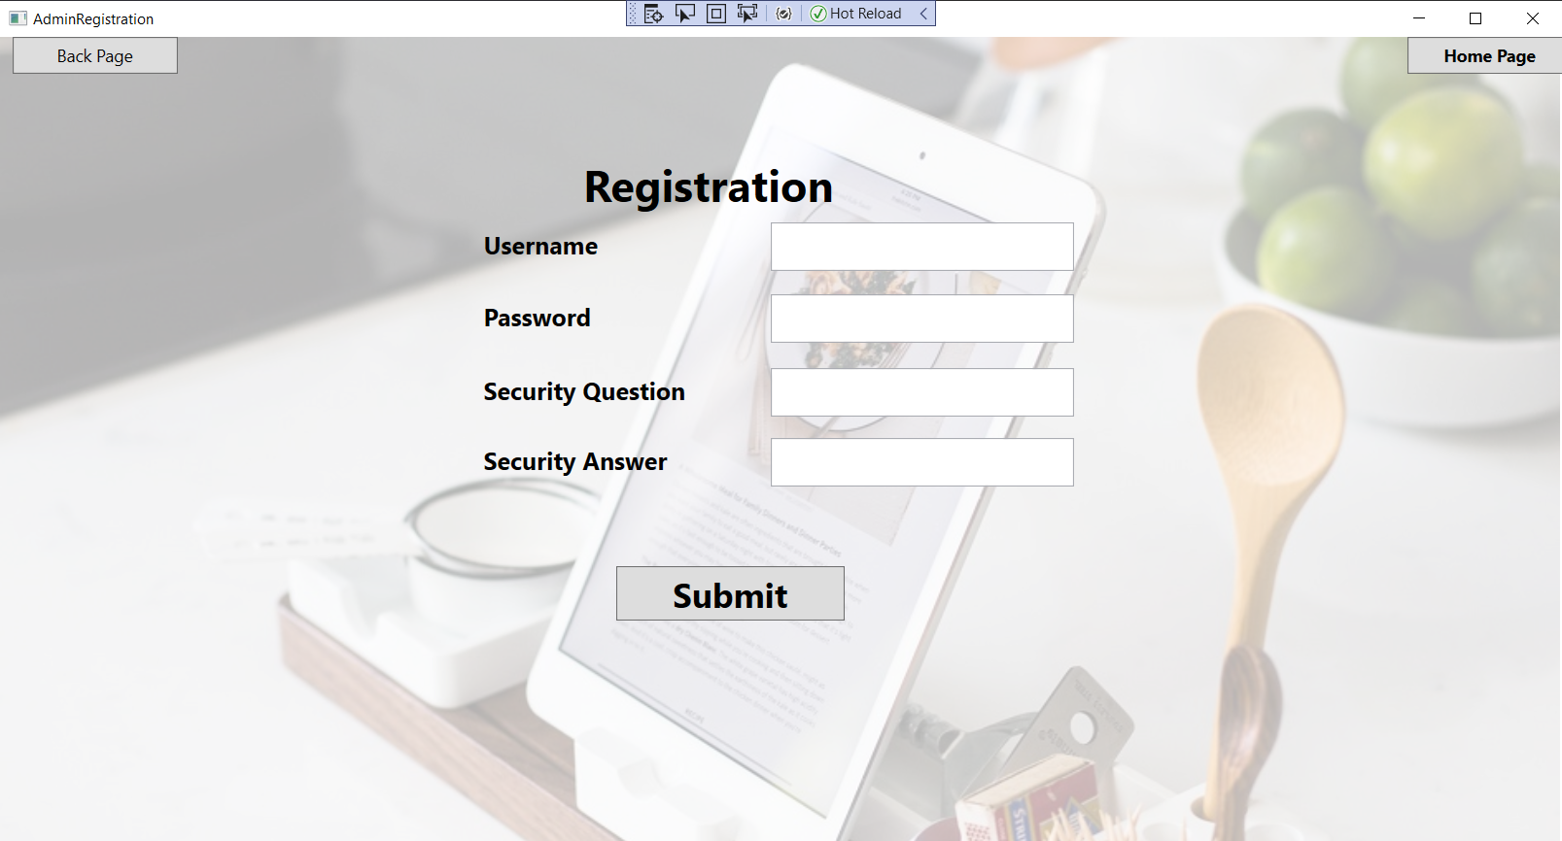
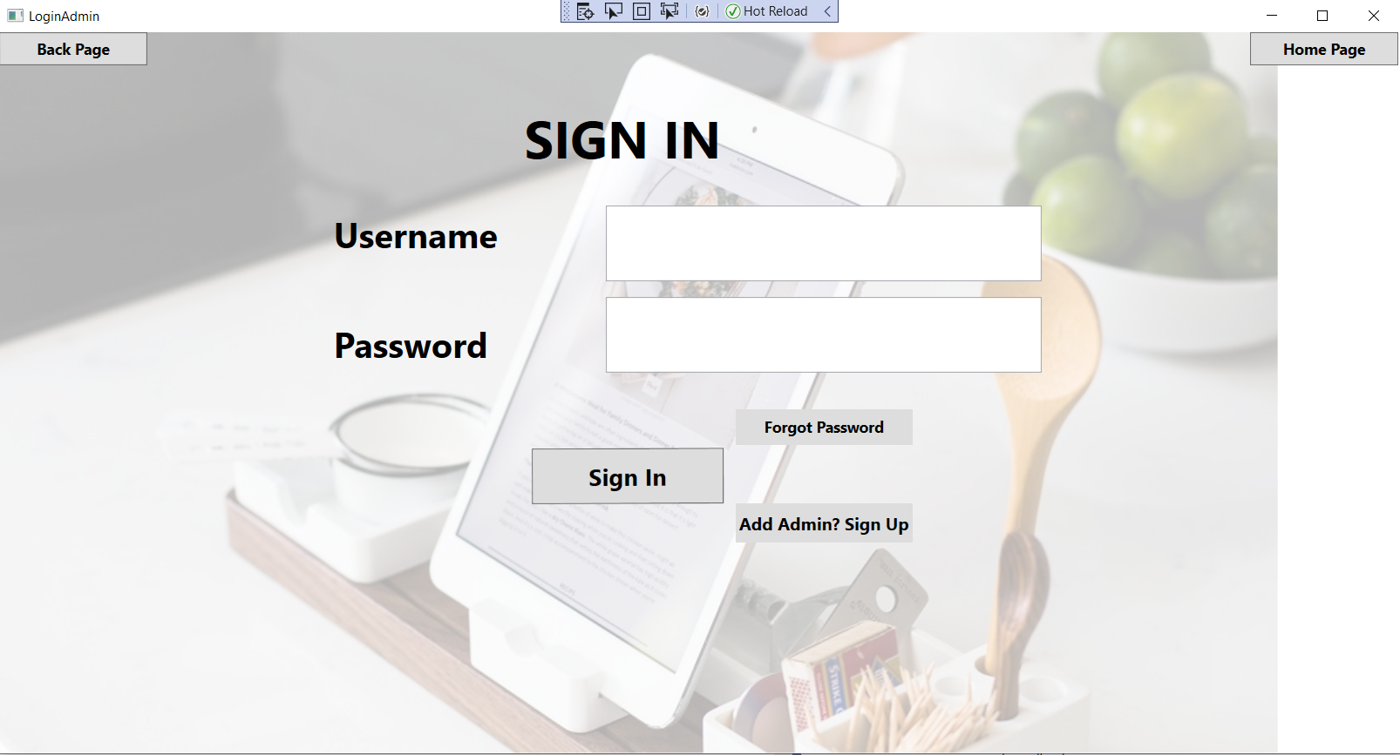
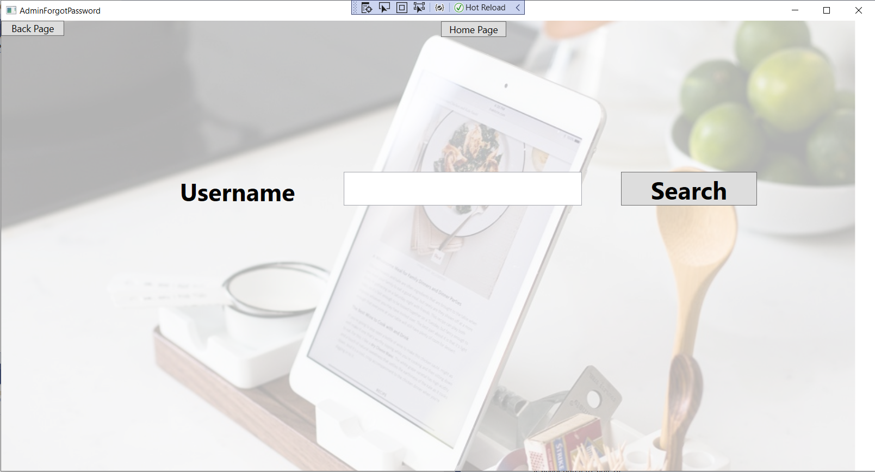
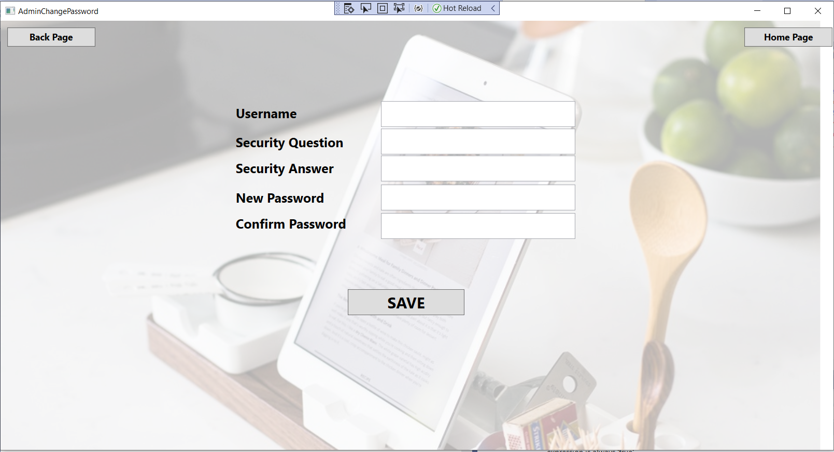
Admin Login Module

Slide 10
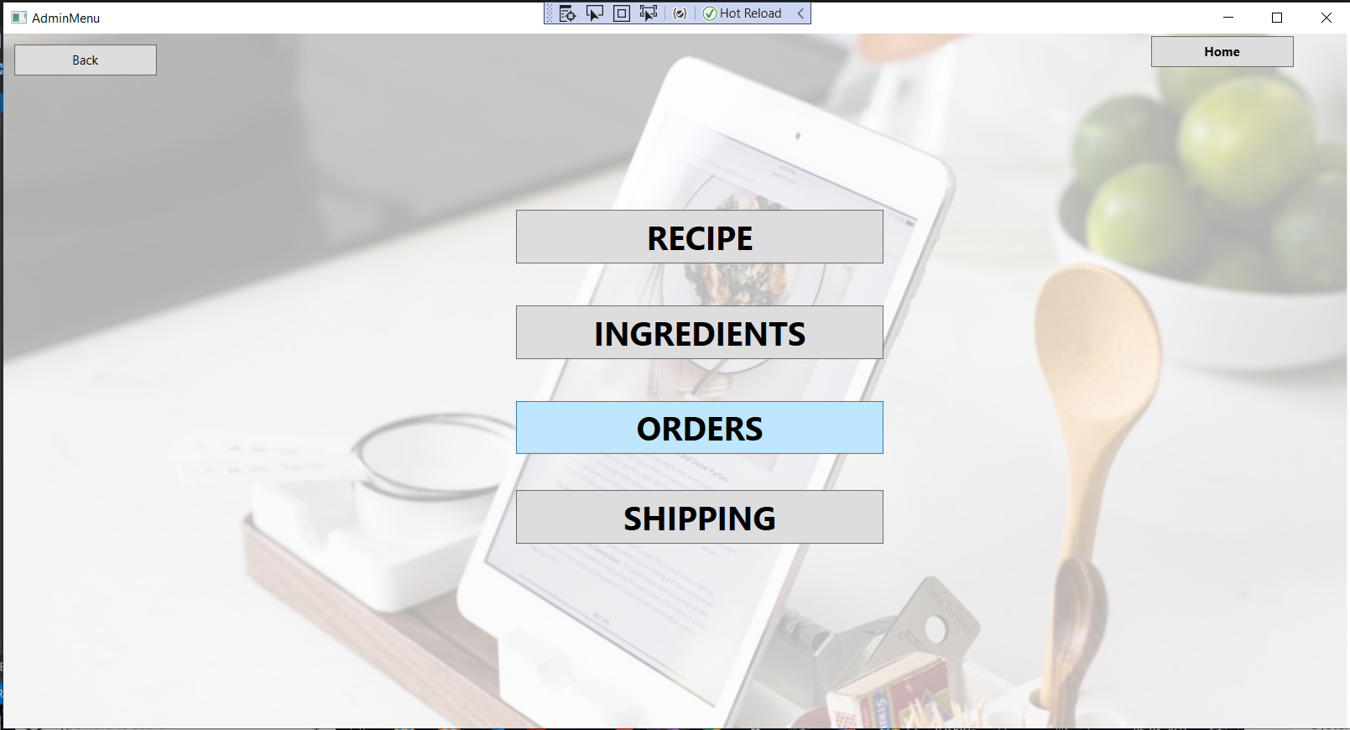
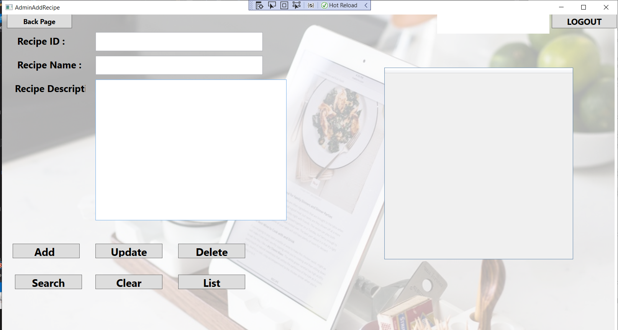
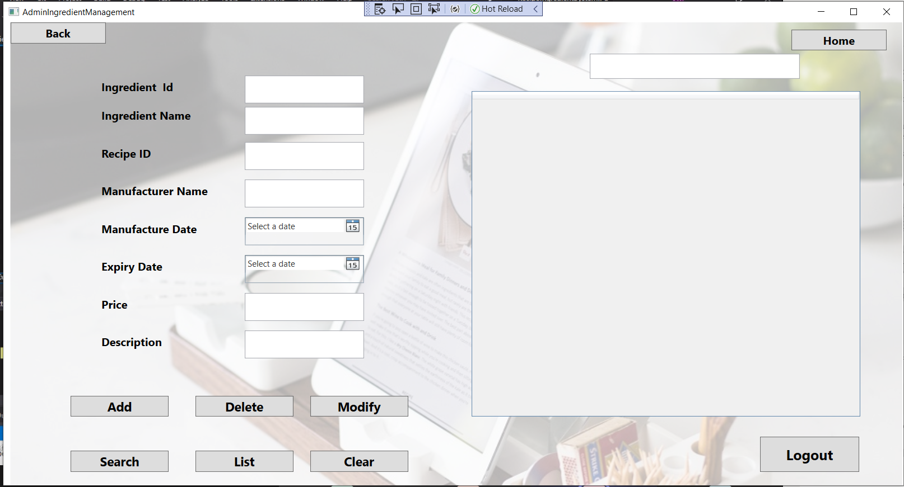
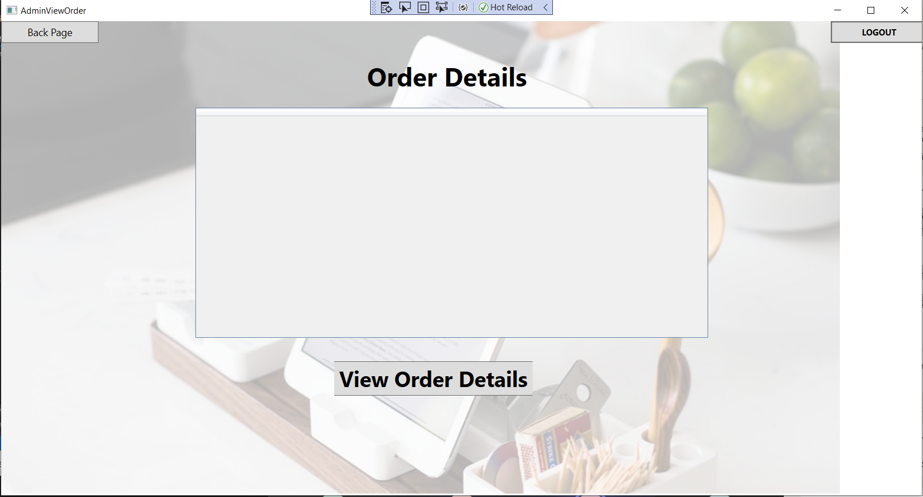
Admin Side of Project

Slide 11
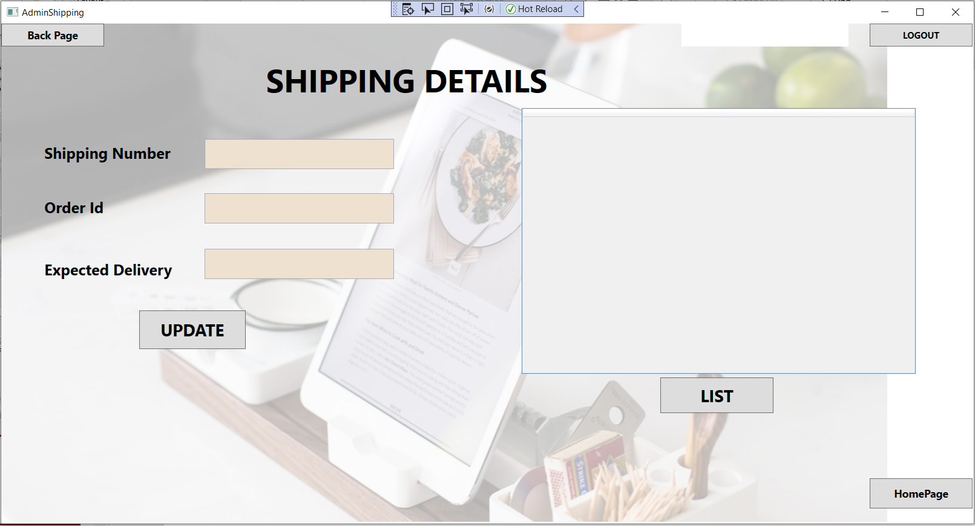

Slide 12
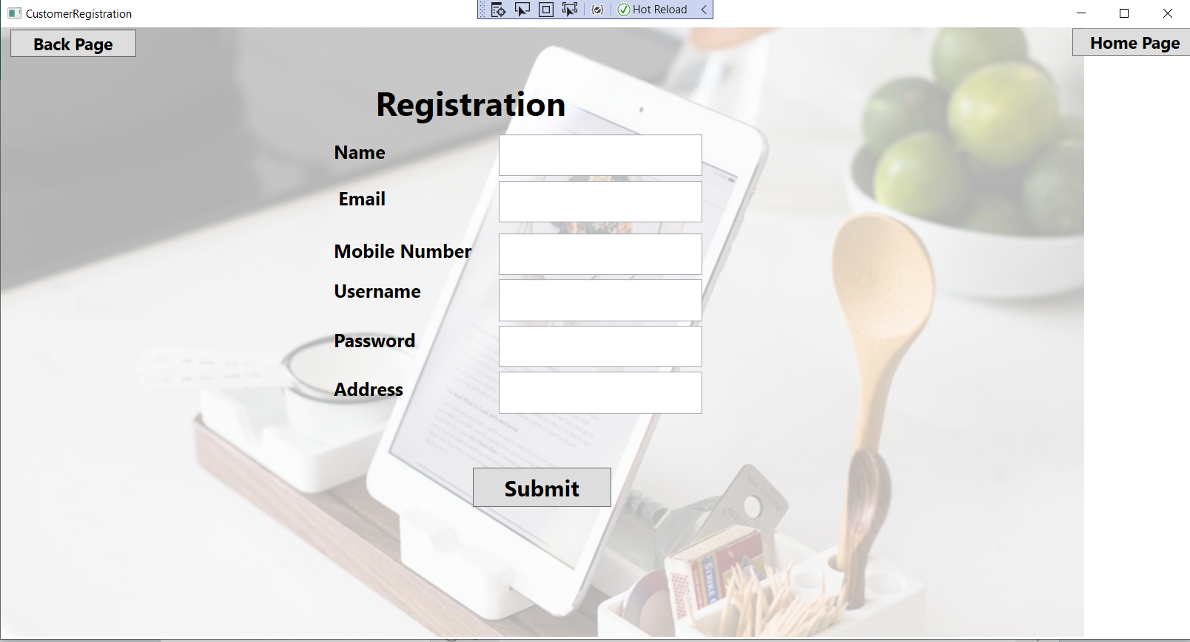
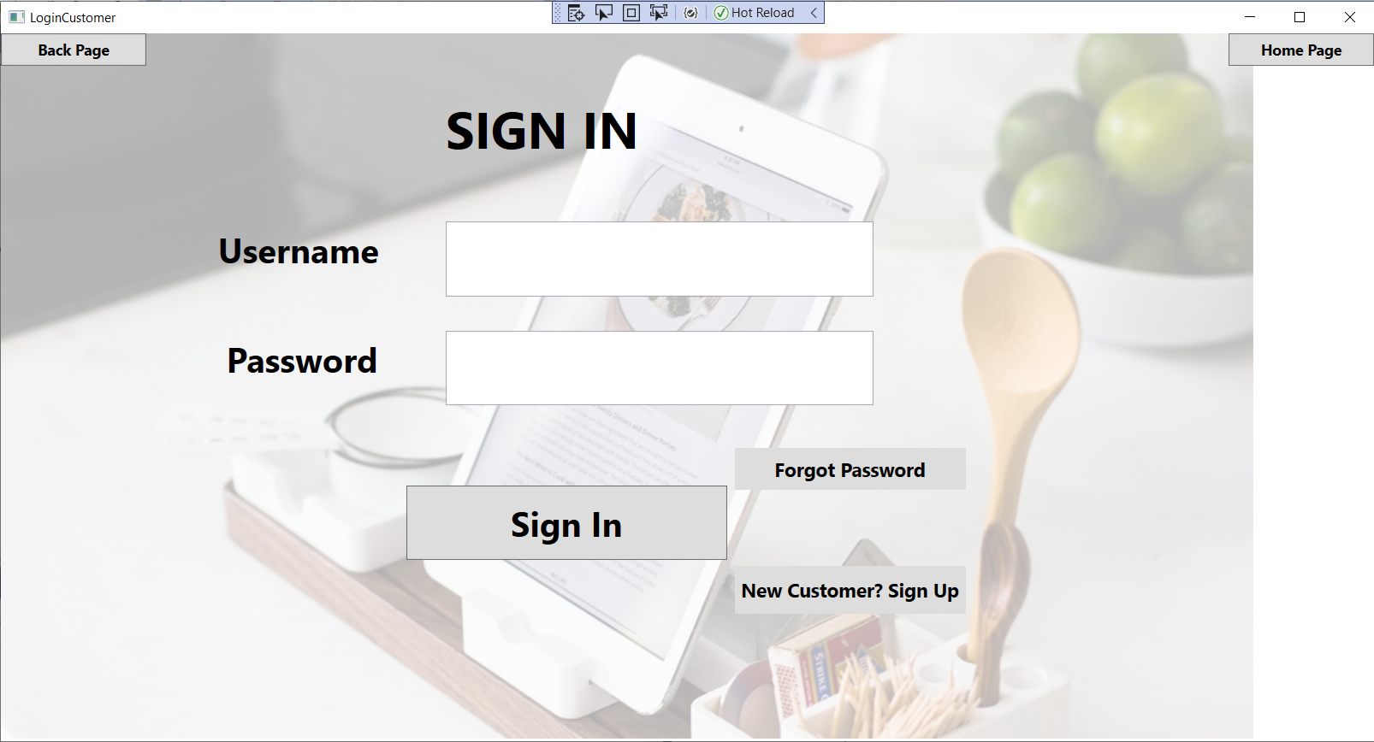
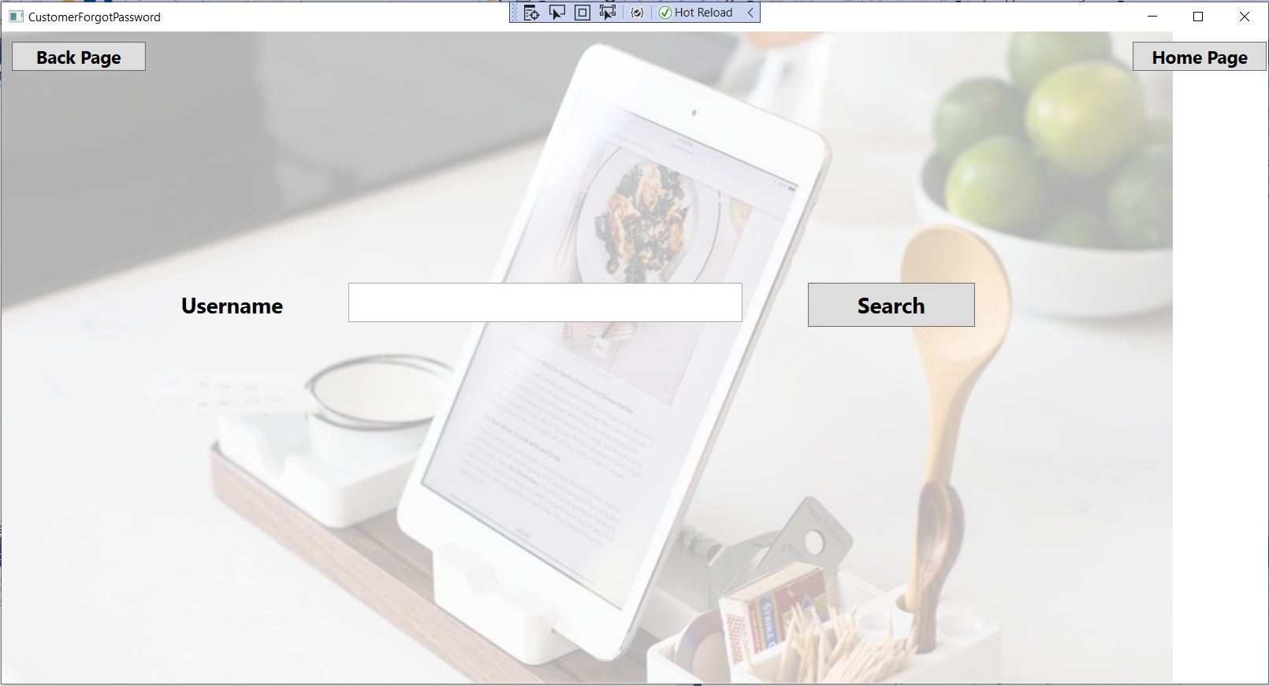
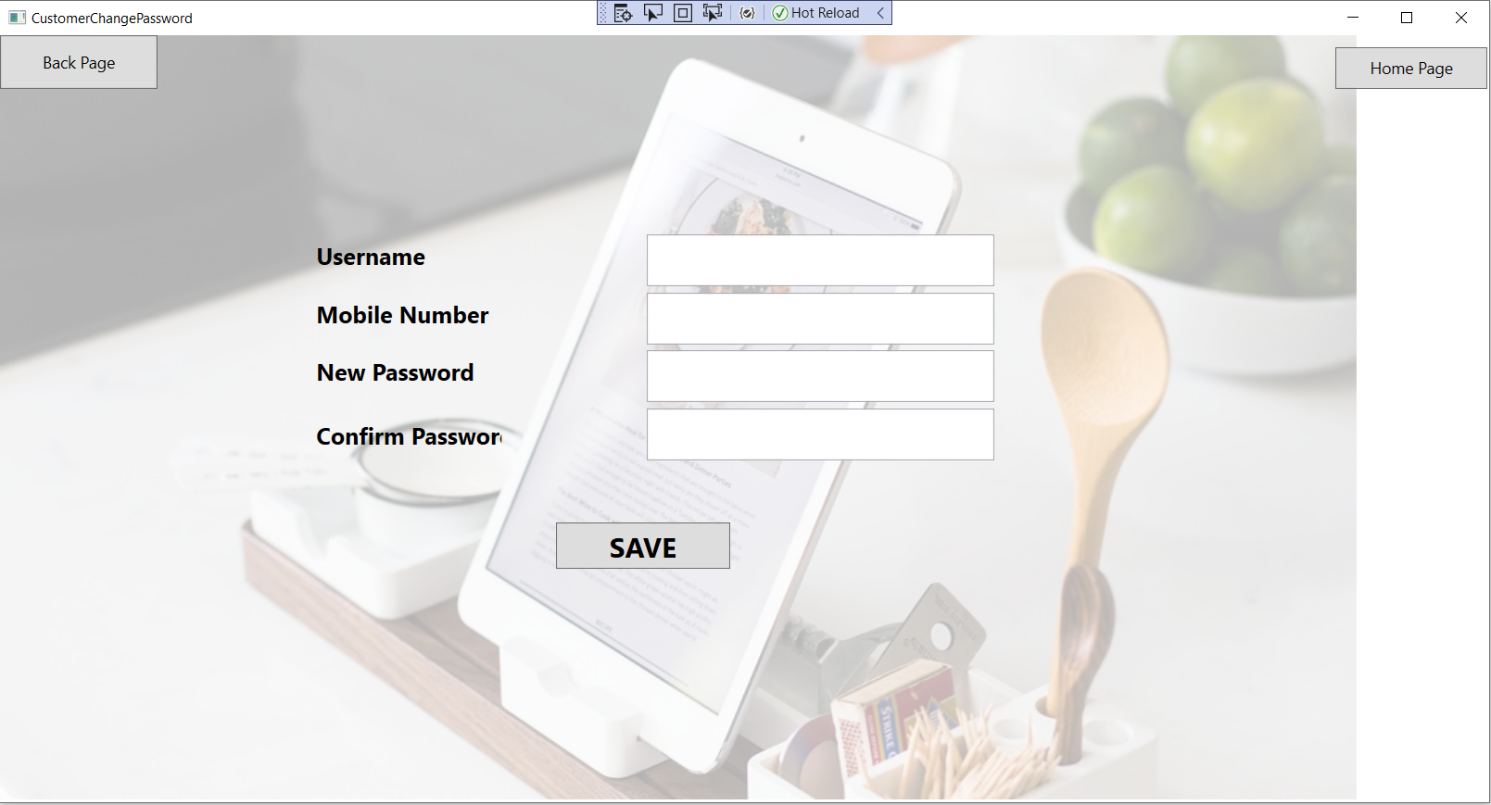
Customer Login Module

Slide 13
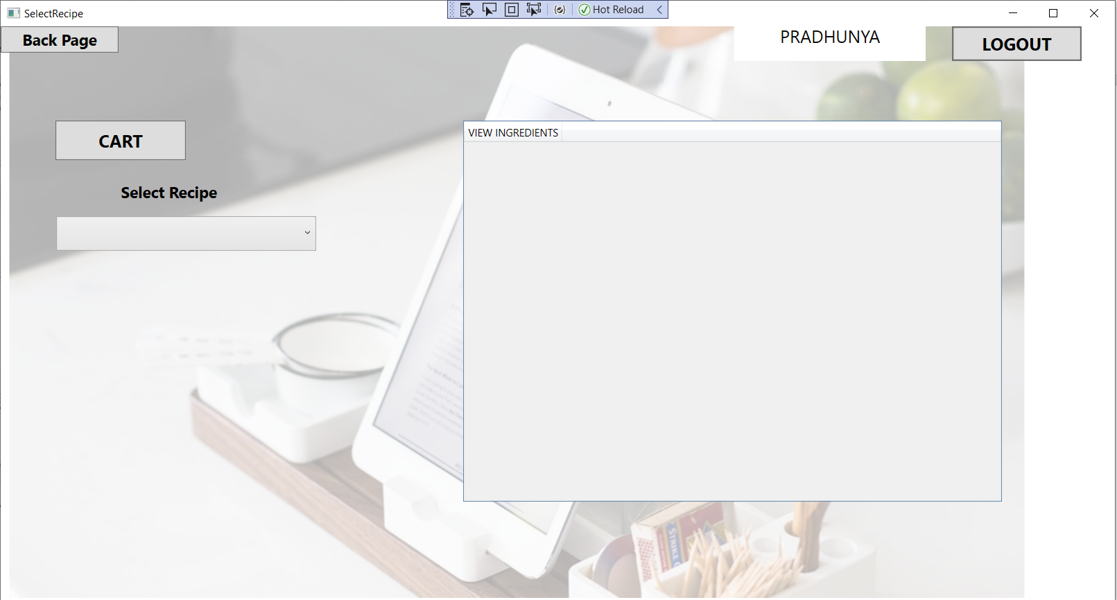
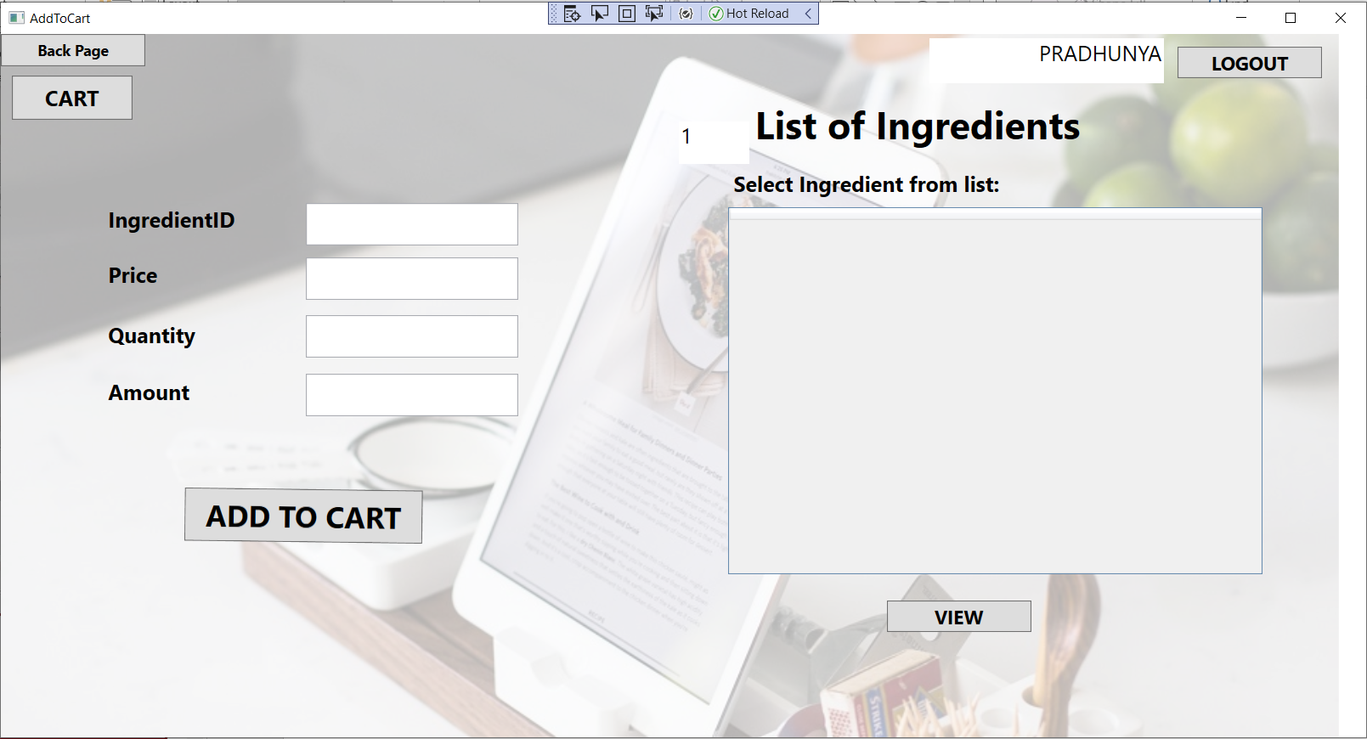
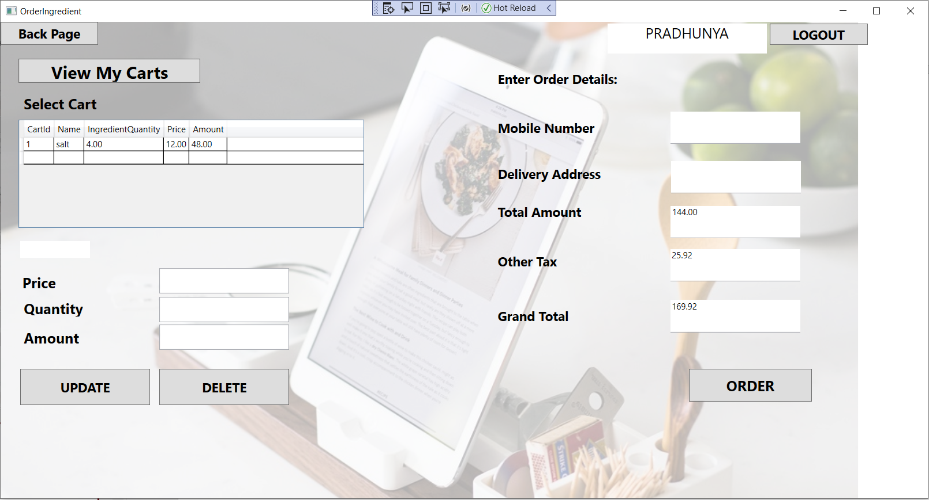
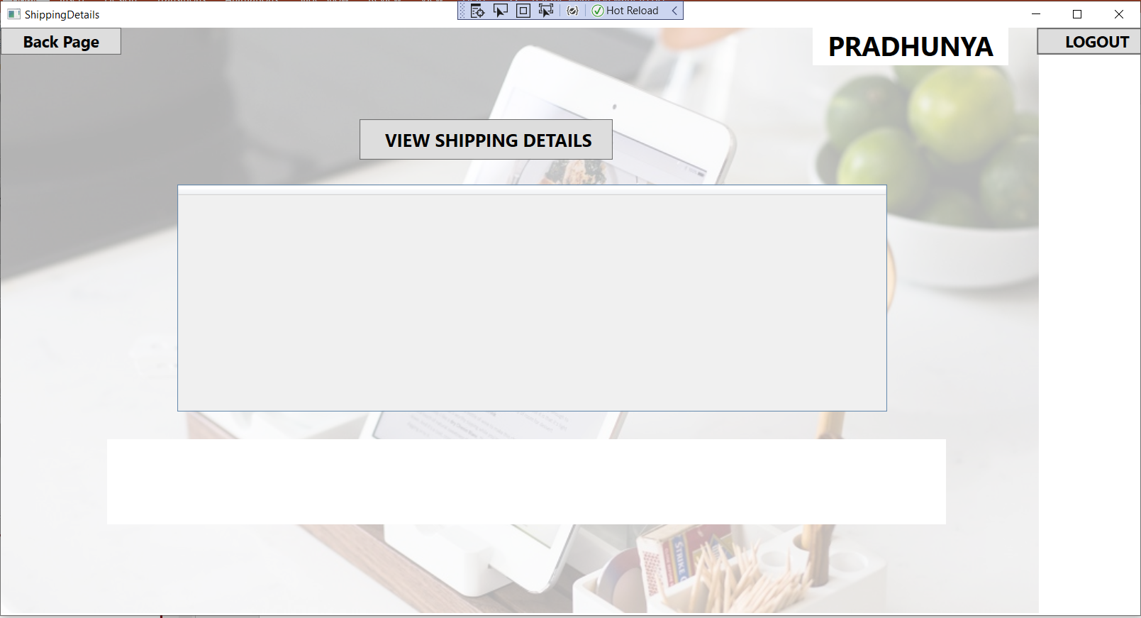
Customer Side of Project

Slide 14
Thank You!

